Slide 1

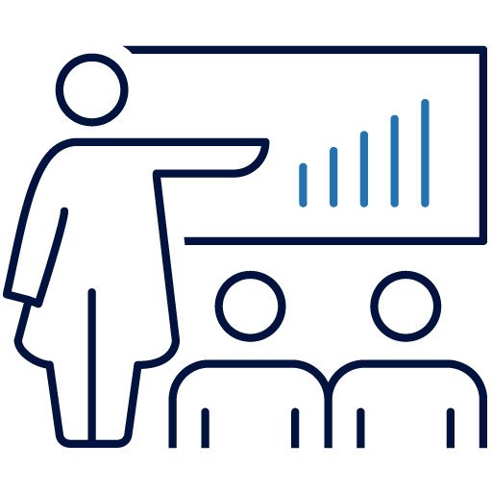


Target operating model redesign and headcount cost reduction for a multi-national veterinary care provider
Client case study
 | Our client was a multi-national veterinary care provider, which had used M&A to rapidly grow its clinic footprint across Europe and North America Teneo was engaged to review its target operating model, with a focus on driving headcount efficiencies by consolidating back-office processes and reviewing clinic structures
 | Teneo tackled the operating model redesign over three phases, with a focus on driving incremental stakeholder alignment as we progressed through the detailed analysis Phase 1 – Design Principles: A set of high-level discussion, anchored in Teneo’s understanding of best practice, to agree the overall targets for the future TOM Phase 2 – Responsibilities & Reporting Lines: A benchmark-led review of the overall organisation to identify material areas of inefficiency, and workshop-style management sessions to align on the future delivery responsibility for all key back-office activities Phase 3 – Organisational Rightsizing: Working closely with each key stakeholder to determine the headcount and management structure required to deliver their agreed delivery responsibilities We separately conducted a detailed review of our client’s largest market to develop a best-practice view of clinic structures, before developing a high-level benefits case for its other markets to identify the potential opportunities
 | The new target operating model delivered a c. £10m net reduction in headcount costs across the back-office functions These changes enabled a further c. £6m in savings at the clinic level, while reductions in the administrative burden on clinical staff created c. £9m in incremental revenue potential
Context
Teneo’s role
Outcome
Centralizing back-office activities enabled our client to unlock c. £16m in headcount savings, and a further c. £9m in revenue potential by freeing up clinical capacity

Slide 2

Program delivery of a complex workplace transition for a FTSE 250 corporate
Client case study
 | Our client was a leading FTSE250 international recruitment consultancy with operations across Europe, the Americas and Asia. They were experiencing industry-high SG&A and poor service outcomes from their back-office functions based in London. Having previously explored an outsourcing agreement with a Big 4 outsourcer which would have been cost-prohibitive, they decided to pursue an in-house option The client had limited experience with successful project delivery and no experience with staff consultation or work transition. After running a formal RFP process (including an in-depth client referencing process), Teneo was selected as the Execution and Subject Matter Expertise partner
 | Teneo engaged in project planning, business case development and active PMO working with workstream leads. We coordinated knowledge management to ensure an appropriate library of Knowledge Artefacts was established before the transition to support training and post-transition Teneo also designed the target organizational model, proposing new reporting structures and RACI matrices for the business as it moved to a Shared Services architecture Teneo supported the consultation process, including providing benchmarks to inform management decision-making as well as scenario modelling. We also conducted detailed transition planning
 | The transition was completed on time and with run-rate benefits 32% higher (£1.3m p.a.) than the Board-approved business case, with a 12% (£1.5m) underspend in exceptional budget The client was able to upgrade talent across a number of areas and even before the completion of the transition was experiencing significant efficiencies and improvement in operational outcomes
Context
Teneo’s role
Outcome
Teneo delivered a critical workplace transition of the back-office which was operationally successful and significantly exceeded planned in-year and run-rate savings

Slide 3




Teneo led the post-merger integration of two technology services consultancies, safeguarding the transition and related synergies
Client case study
 | Our client was a global leader in digital transformation and experience innovation Our client had recently acquired a consultancy specializing in digital transformation and data-driven solutions to enhance its geographic reach and service offerings Following Teneo’s work developing the businesses’ pre-completion integration plan, we were subsequently engaged to provide strategic PMO support across the first 100 days of the integration with a focus on realising the cost synergies and executing the implementation activities outlined in the integration plan
 | Teneo’s role involved hands-on support to drive integration progress, troubleshoot issues, and ensure consistency across all workstreams Teneo held regular meetings with People & Culture and function leads to track synergy delivery, align on end-state organizational structures, and monitor critical data such as notification dates and one-off costs Teneo worked closely with various business stakeholders to align benefit realization across companies and geographies, and ensure measurable results
 | Teneo helped the business to secure $20.6m in run-rate savings, comprised of $6.0m in non-headcount and $14.6m in headcount optimisation, including material synergies in Finance, Operations, Sales and Delivery teams Teneo facilitated a seamless integration of the two businesses whilst keeping relevant stakeholders, including executive, board, and investor stakeholders informed with regular updates to ensure alignment and approval of key decisions
Context
Teneo’s role
Outcome
Teneo achieved material outperformance of original planned synergies, together with a seamless integration

Slide 4

Teneo was asked to support the integration of Texthelp and n2y across the “first 100 days” through Project Calypso
Client case study
 | Texthelp is a leading global provider of literacy and numeracy assistive technologies merged with n2y, another leading US-focussed provider of technology to learners with special needs Both businesses realised the importance of ‘hitting the ground running’ with their integration activities and set Jan 2025 as the deadline for their North American orgs to be operating as one unit As part of this effort, Texthelp wished to redesign its data architecture and identify opportunities for data automation and AI
 | Teneo proposed supporting Project Calypso during 2024, with a full range of integration activities, including: Integration office: We facilitated and drove progress across each of the workstreams defined by management Synergy realisation: Our team monitored and tracked the realisation of cost and revenue synergies Light-touch organisational design: We leveraged our senior expertise in org design to ensure that the combined organisation has an optimal structure and achieved the synergy target
 | Teneo equipped the client with an integration plan for each workstream with ‘crisp summaries’ of workstream objectives, milestones and owners alongside workstream performance management We also provided a detailed analysis on the proposed org design, pinpointing areas for improvements, alongside a benefits model to track the cost saving In partnership with our client’s Chief Data Officer, Teneo implemented a central data lake, including machine learning and AI to automate customer insight This has been mobilised to improve customer insights but is being further developed to productise data and implement further operational improvements
Context
Teneo’s role
Outcome
The deliverables were well-received by our client, positioning them for a successful transition to a self-delivery model after the first 100 days

